Slide 1
Overview
Overview
Nodes
Practical Example
The goal is to design an autonomous vehicle that when detecting an obstacle, avoids it.
The vehicle can switch between two lanes, where on obstacle detection, the vehicle switches to the other lane.
The vehicle uses two microcontrollers: an ESP32, Raspberry Pi 5.
The ESP32 takes the sensor readings and sends them to the Pi, while at the same time takes the motor commands from the Pi and sends them to the motors.
Two sensors are used: An Encoder for getting velocity, and an IMU for getting the heading angle and its respective angular velocity.
Two motors are used: A DC motor for longitudinal motion, and a Servo motor for steering.

Slide 2
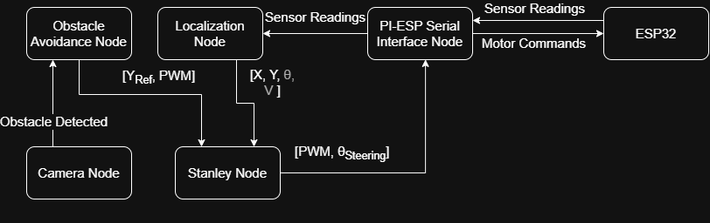
Overview
Overview
Nodes
Practical Example
The following figure shows an overview of the Raspberry Pi nodes used in our project:

Slide 3
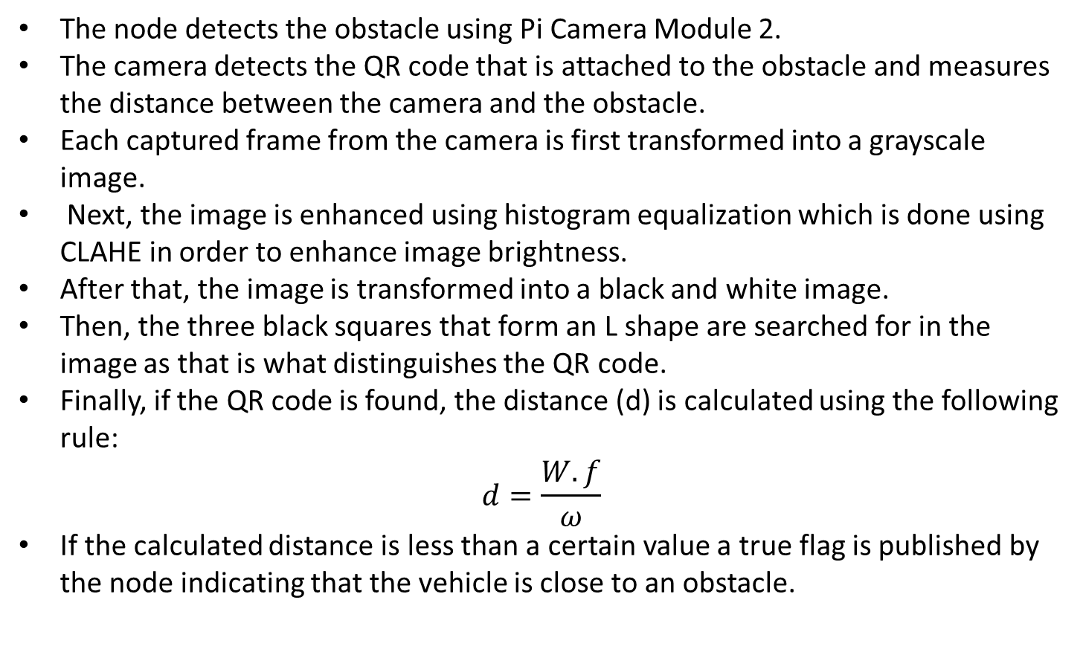
Camera Node
Overview
Nodes
Practical Example
The node detects the obstacle using Pi Camera Module 2.
The camera detects the QR code that is attached to the obstacle and measures the distance between the camera and the obstacle.
Each captured frame from the camera is first transformed into a grayscale image.
Next, the image is enhanced using histogram equalization which is done using CLAHE in order to enhance image brightness.
After that, the image is transformed into a black and white image.
Then, the three black squares that form an L shape are searched for in the image as that is what distinguishes the QR code.
Finally, if the QR code is found, the distance (d) is calculated using the following rule:
$$d=\frac{W.f}{ω}$$
If the calculated distance is less than a certain value a true flag is published by the node indicating that the vehicle is close to an obstacle.
W: Real width of the QR code
f: Focal length
ω: Pixel Width

Slide 4
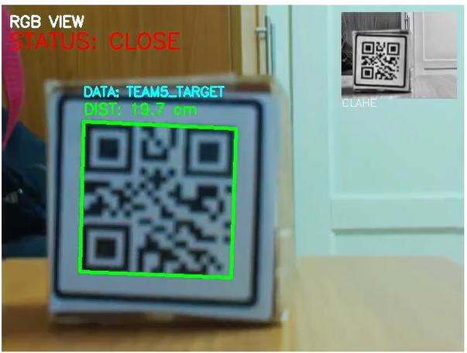
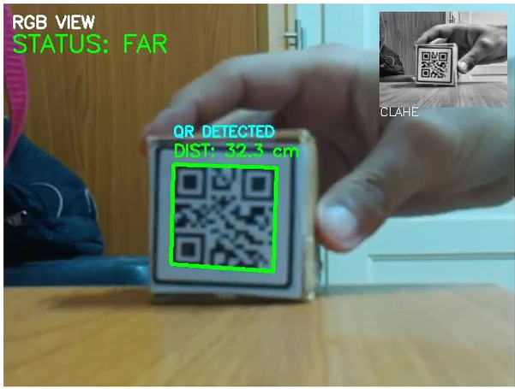
Camera Node
Overview
Nodes
Practical Example

Slide 5
Obstacle Avoidance Node
Overview
Nodes
Practical Example
The node takes the published flag by the camera node.
A majority filter is used to prevent camera noise affecting the vehicle.
On obstacle detection, the reference Y value is changed representing our lane switching.
The node also controls the speed of the vehicle, where the vehicle normally moves at a constant speed.
On obstacle detection, the vehicle moves with a lower speed until it moves past the obstacle.

Slide 6
Localization Node
Overview
Nodes
Practical Example
The node is responsible for making the vehicle know its current state values [X, Y, ϴ, V].
This is done by using the sensor readings of the encoder and the IMU.
An Extended Kalman Filter is used, so that the vehicle knows its current states accurately.

Slide 7
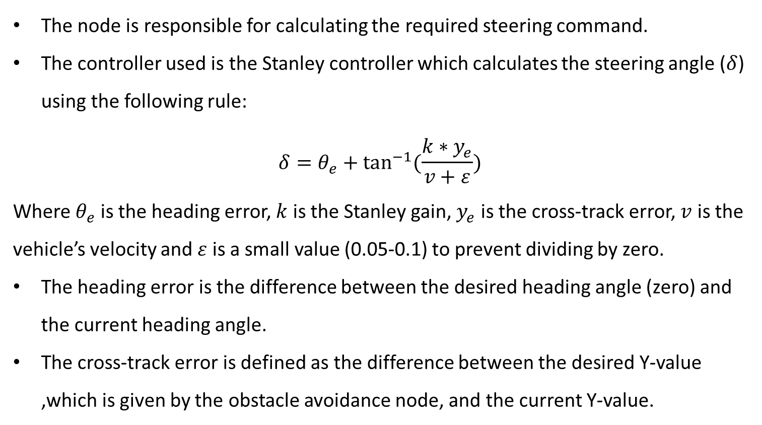
Stanley Node
Overview
Nodes
Practical Example
The node is responsible for calculating the required steering command.
The controller used is the Stanley controller which calculates the steering angle ($δ$) using the following rule:
$$δ=θ_{e}+\tan^{−1}{(\frac{k∗y_{e}}{v+ε})}$$
Where $θ_{e}$ is the heading error, $k$ is the Stanley gain, $y_{e}$ is the cross-track error, $v$ is the vehicle’s velocity and $ε$ is a small value (0.05-0.1) to prevent dividing by zero.
The heading error is the difference between the desired heading angle (zero) and the current heading angle.
The cross-track error is defined as the difference between the desired Y-value ,which is given by the obstacle avoidance node, and the current Y-value.

Slide 8
Pi-ESP Serial Interface Node
Overview
Nodes
Practical Example
The node takes the sensor readings from the ESP32 and sends them to the localization node.
The node also takes the PWM and steering angle from the Stanley node and sends them to the ESP32.

Slide 9
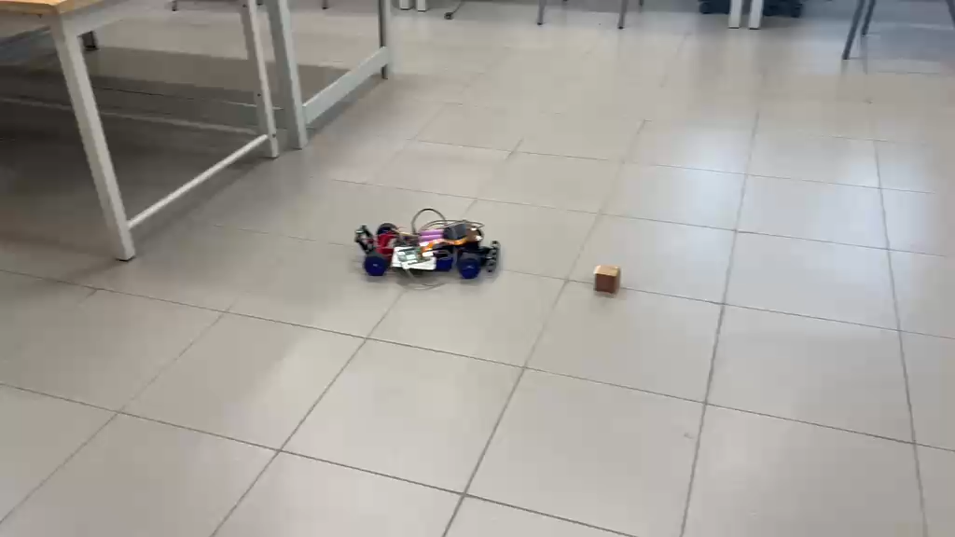
Practical Example
Overview
Nodes
Practical Example

